Slide 1
What do you think is the percentage of calls that reject the campaigns out of all the calls made?

Slide 2

Bank Tele-Marketing Campaign Analysis
Presented by:
Shimaa Alaa
Rawan Hossam
Abdullah Ashraf
Abdalla Hamdi

Slide 3
Agenda
I. Introduction & Dataset Overview
Setting the stage for our analysis.
IV. Visualization of Key Trends
Making complex data accessible and understandable.
II. Data Cleaning Process
Ensuring data quality and reliability.
V. Insights & Recommendations
III. Exploratory Data Analysis (EDA)
Translating findings into strategic actions.
Uncovering initial patterns and relationships.

Slide 4
Objective
To understand customer characteristics and behaviors that influence deposit subscription, identify patterns in demographic and contact-related features, and provide actionable insights to improve bank marketing campaigns.

Slide 5
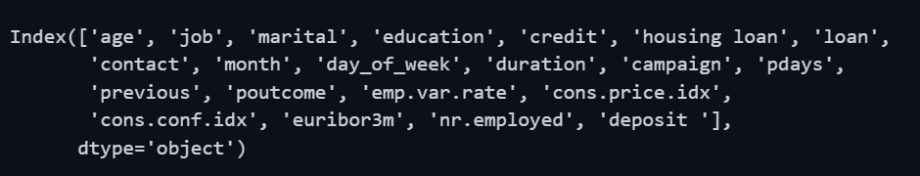
Introduction to data & Dataset overview
Our analysis is built upon a rich dataset sourced from a marketing campaign conducted by a Portuguese bank. This dataset provides a detailed look into customer demographics and their interactions with the campaign.Includes demographic data such as age, job, marital status, and education.Captures campaign interaction details: contact type, month, call duration, and previous campaign outcomes.The crucial target variable is "deposit", indicating whether a client subscribed to a term deposit (yes/no).

Slide 6


Data cleaning process
Duplicate Removal
Missing Value Handling
Eliminating redundant records for unbiased analysis.
Addressing gaps and inconsistencies in the data.
Outlier Management
Column Renaming & Dropping
Ensuring realistic data distribution for accurate insights.
Enhancing clarity and removing irrelevant features.

Slide 7

Precision in Data: Addressing Duplicates and Naming Conventions
Handling Duplicates
Column Name Adjustments
During our initial scan, we identified 12 duplicated rows within the dataset. These records were exact replicas across all columns, posing a significant risk for bias in our analysis.
To enhance clarity and consistency, we made several adjustments to the column names. An unnamed column was identified and removed due to its lack of meaningful data, streamline the dataset.
Additionally, three key columns were renamed for better readability:
Action Taken: All 12 duplicated rows were successfully removed. This ensures that our subsequent analysis operates on a unique and reliable set of customer interactions, preventing skewed results and misleading conclusions.
housing was changed to housing loan
default was changed to credit
y (the target variable) was changed to deposit

Slide 8
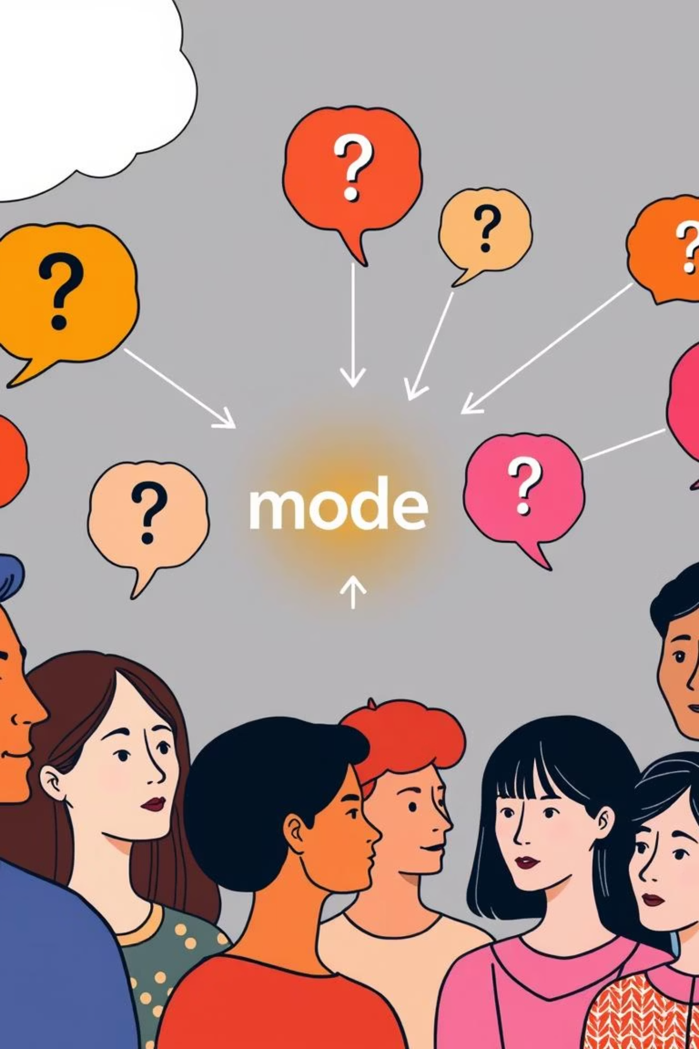

Resolving Missing Values: The "Unknown" Challenge
A significant challenge in the raw dataset was the high percentage of "unknown" values found across critical demographic and contact columns. These included:
Demographics: age, job, marital, education, default, housing, loan
Campaign Details: contact, month, day_of_week
Solution Implemented: To preserve data integrity and prevent data loss, we opted to replace all "unknown" values with the mode (most frequent value) of their respective columns. This method ensures that our dataset remains comprehensive while mitigating the impact of missing information on our analysis.

Slide 9



Exploratory Data Analysis (EDA)
With a clean dataset in hand, we moved to the exploratory phase, uncovering initial patterns, relationships, and insights that will guide our understanding of customer behavior and campaign effectiveness.
Relationships
Patterns
Outliers
Distribution

Slide 10
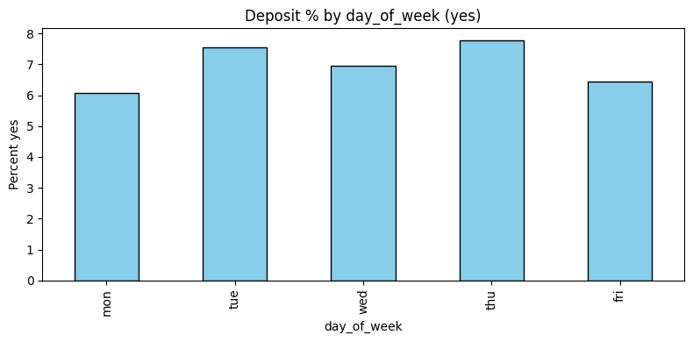
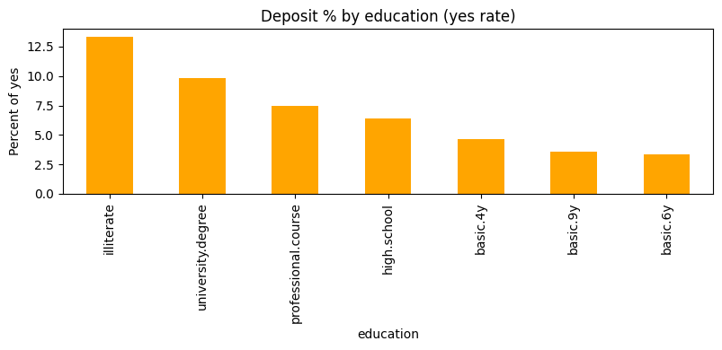
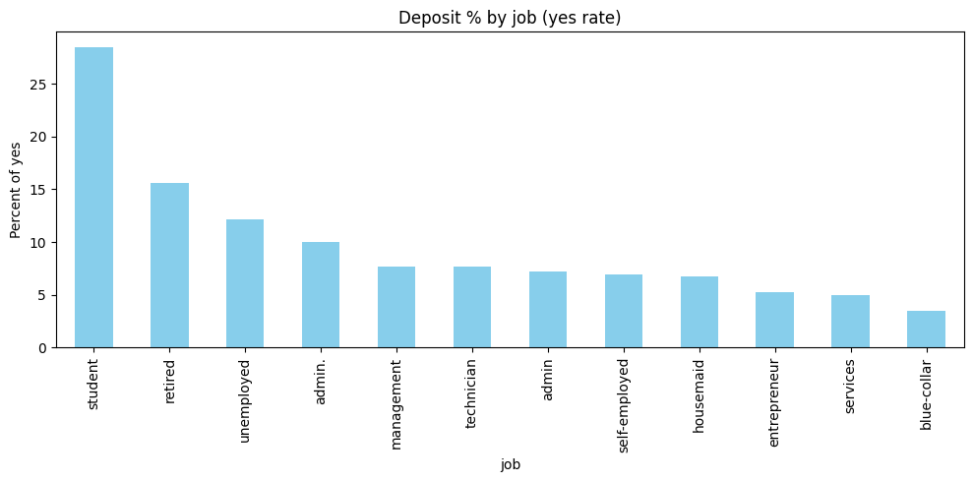
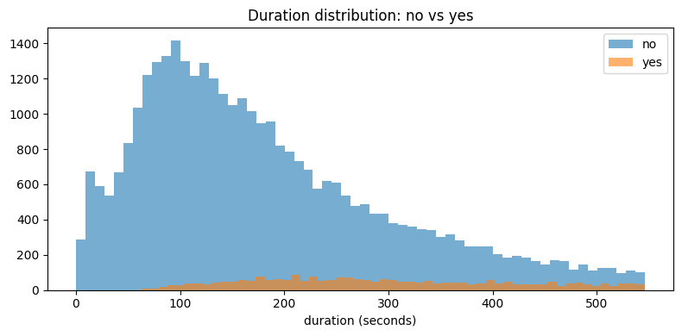
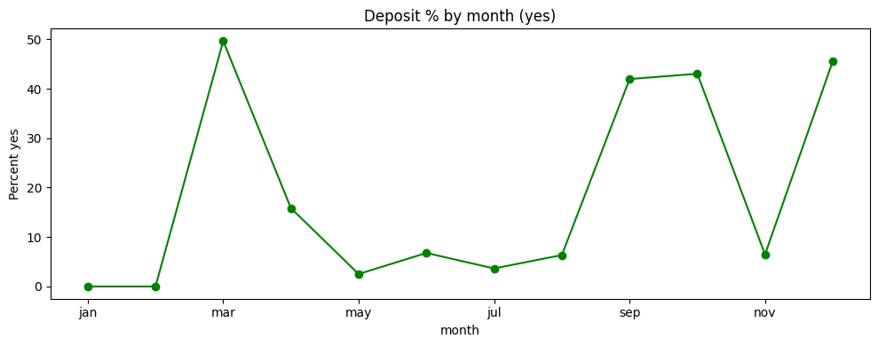
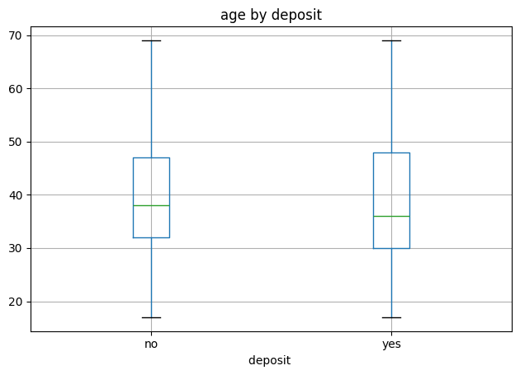
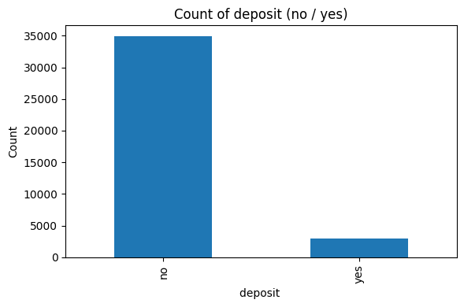
Visualization of Key Trends

Slide 11
Next Steps: Driving Actionable Insights
With our clean dataset, we are now poised to delve deeper into the data, extracting valuable insights to enhance future marketing strategies.
1
2
3
Most of the people did not respond to the call
The targeted- audience were not interested as they had loans and credits
The new customers respond with yes more than the old customers
4
5
The married’s yes and no percentage ware approximately equal, while singles and divorced percentage had difference
The yes percentage was huge in the age between 20-30 more than the above 60

Slide 12
Thanks for listening

